Slide 1
SOFTWARE ENGINEERING PROJECT
Online Delivery Service

Slide 2
Group
Group Name:
Milestone
Group members:
1. Hasib Ahmad (F17040108)
MD Torikul Islam (F17040104)
Saif Haque (F17040102)
Zafar Iqbal (F17040119)
Shoaib Ahmed (F17040116)

Slide 3

Project Title
Online Delivery Service

Slide 4
Project Vision:
1. A customer can create his own account to interact with the shop merchants in in terms of delivery service.
2. Users can alter their specific data by logging in to the software any given time.
3. All the information will be saved in database an can be checked from the activity logs.

Slide 5
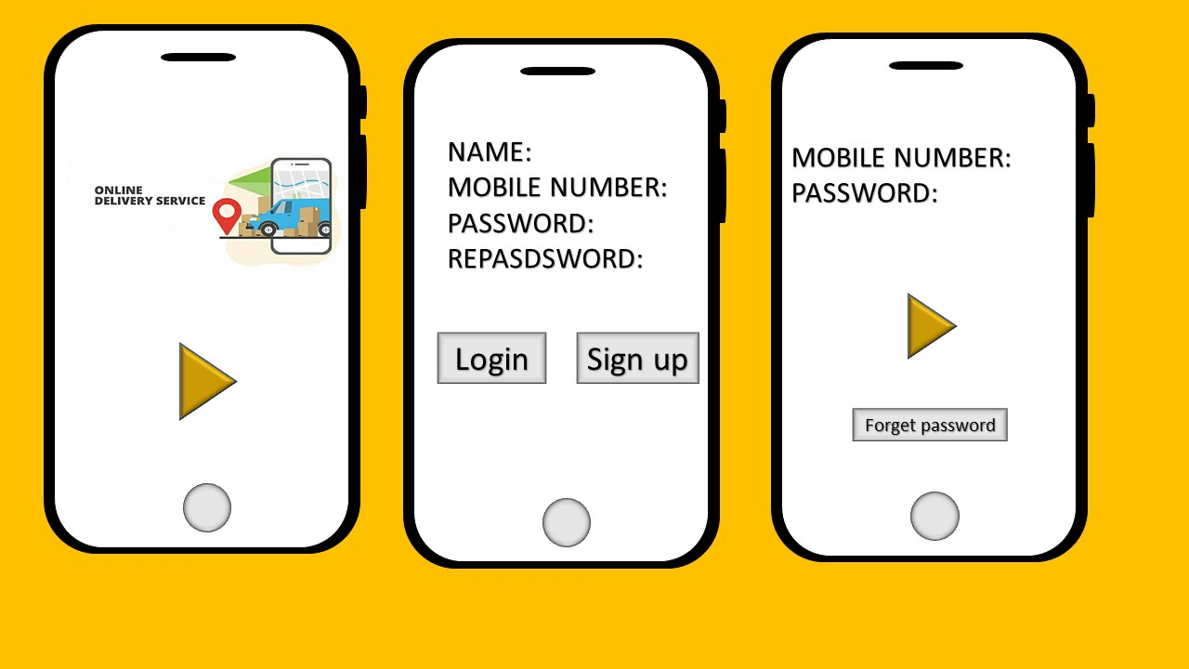

Slide 6
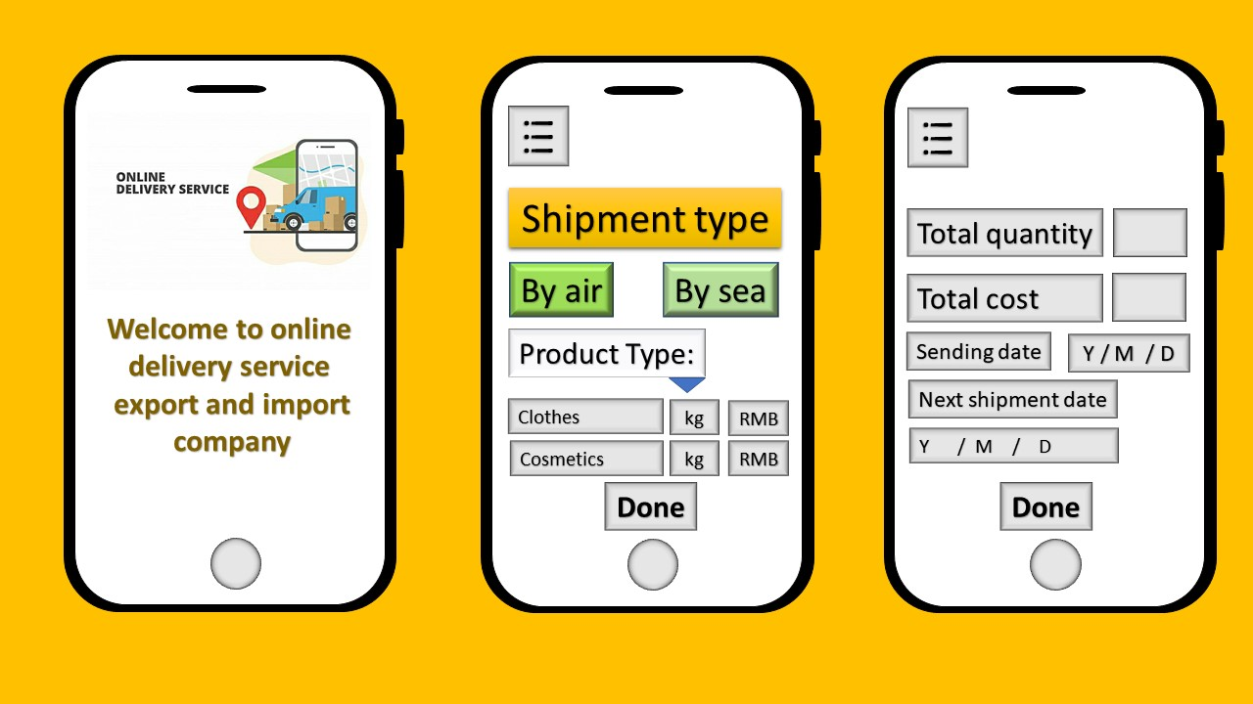

Slide 7
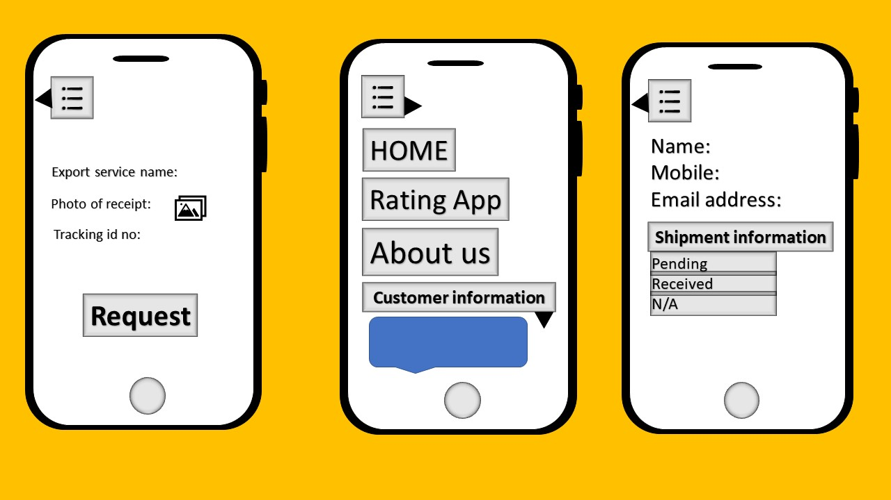

Slide 8
Associated tools and Language:
1. Language: JAVA
2. Toolkits:
JDK(Java Development Kit)
SDK(Software Development Kit)
Android Studio
ICO converter (to convert image into icon)
3. Mobile Application Development Platform: Firebase for database 4. REST API

Slide 9
OUR PROSPECTS:
User friendly application
Stabilizing e-marketing and e-commerce for the upcoming generations
Less consumption of time for users

Slide 10
THANKS IN ADVANCE TO OUR HONORABLE TEACHER AND TEAM MEMBERS WHO WILL BE WORKING HARD THROUGHOUT THE PROJECT

